Slide 1


Slide 2
INTRODUCTION AND GOAL
Bike sharing systems are a means of renting bicycles where the process of obtaining membership, rental, and bike return is automated via a network of kiosk locations throughout a city. Using these systems, people are able rent a bike from a one location and return it to a different place on an as-needed basis.
The aim of this project is predict bike sharing demand under various circumstances(temperature, humidity, whether it is holiday or not etc.) by using Machine Learning. It is important to predict the demand especially in big cities because customers may refuse to rent if they wait too long which may cause both economical problems and customer dissatisfaction to bike sharing company and they may not amortized their bikes in time and lost the trust of their customer. Opposite to that factor, if demand prediction went wrong and company increase the amount of bikes in their fleet, they may waste their money with such unnecessary expenses. That is why our machine learning application is a life saver for such systems.

Slide 3
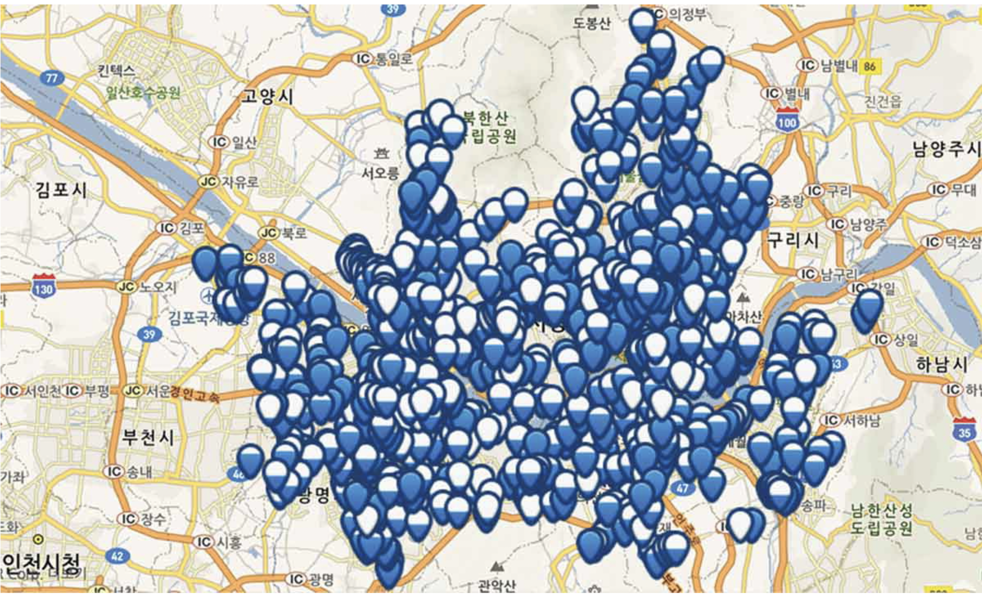
Seoul Bike Sharing Map

Slide 4
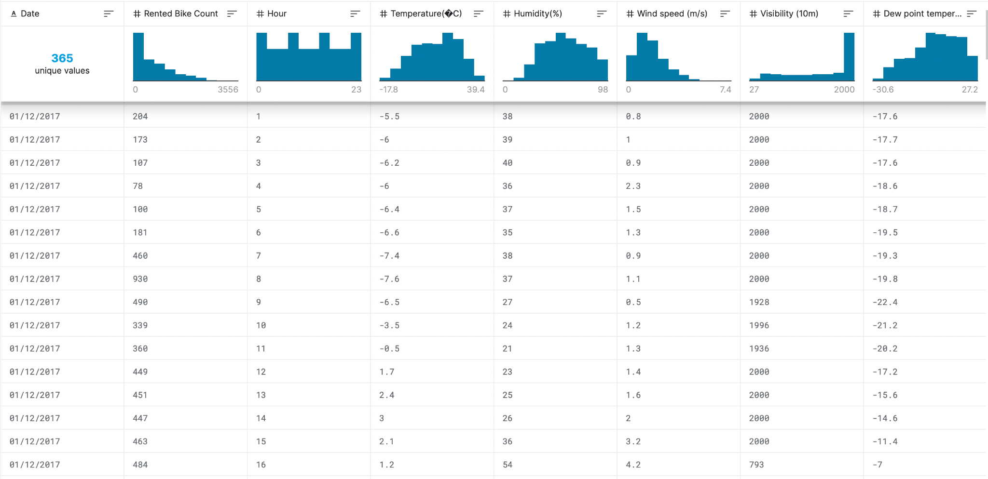
DATA OVERVIEW
Our dataset accomplished form Kaggle.
Dataset has ten columns which are;
-Date (day-month-year)
-Rented Bike Count
-Hour (time of the day)
-Temperature (Celsius)
-Humidity (%)
-Wind Speed (m/s)
-Visibility
-Dew Point Temperature (Celsius)
-Solar Radiation
-Rainfall (millimeter)

Slide 5
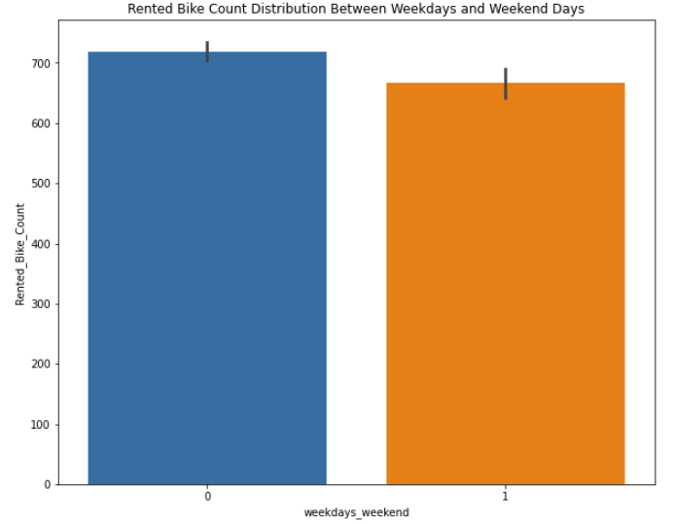
EDA AND DATA VISUALIZATIONS
Before we start modelling, let us first get an idea on how the number of bike rentals depend on the various features provided to us.
Weather
Season
Working Day
Holiday
Temperature
Hour
Month

Slide 6
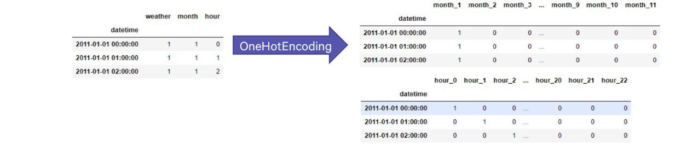
FEATURE ENGINEERING
The provided data in its raw form wasn’t directly used as an input to the model. Several feature engineering was carried out where few features were modified, few were dropped, and few were added.

Slide 7
TRAIN/TEST SPLIT
1. Training set
(a) This contains data of from the 1 st to 17th of every month
(b) This set is used to train various model and obtain the best set of hyperparameters for these models. We use GridSearchCV to tune the hyperparameters using this training set

Slide 8
TRAIN/TEST SPLIT
2. Test set
(a) This contains data of from the 18th to 19th of every month
(b) This is used to evaluate all our models. The model with the best test score is finally chosen for submission

Slide 9
MODELLING
Regression algorithms used.
Linear Algorithms
Ensemble Algorithms
Stacking Algorithms where predictions from Linear and Ensemble methods were used to make final predictions.

Slide 10
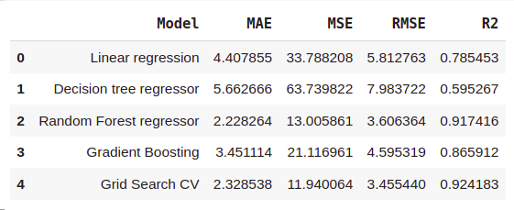
METRICS

Slide 11
DISCUSSION
The results we obtained, especially in random forest and gradient boosting models, show us that the most important factors in people's rental bike preferences are weather events such as humidity and temperature.
We combined these with the name of functioning day by generalizing. Another part is the hours of the day. The dominance of the preferences between 3-7 p.m. can be seen. Seasons and months have little effect.

Slide 12
DISCUSSION
It seems that people are looking for more rental bikes during the hours when the humidity is high and the temperatures are suitable for sightseeing and after work hours. If we make a sociological evaluation of the work, the correct prediction rate of our models is quite high.
In addition, although the predictions seem effective in general, especially in the linear regression model, it cannot be said that the problem we are dealing with is suitable for linear regression, and the reason for this can be shown as both the large number of outliers that appear and the fact that the predicted parts have no closeness with the actuals at some points.

Slide 13
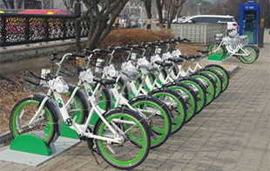
CONCLUSION
-We used EDA (Exploratory Data Analysis) method to interpret the obscure relationships and trends well.
-We looked at quantitative variables, determining their correlation, distribution, and link to the dependent variable.
-We hot encoded the categorical variables and deleted certain numerical features with primarily 0 values.
-We implemented four methods that are linear regression, decision tree, random forest and gradient boosting.

Slide 14
CONCLUSION
Some important results that we found:
No overfitting was observed.
Feature importance values ​​in random forest and gradient boost were different.
The r2 score in random forest regression was very high compared to the others (91%).
Our data is time-dependent, it might not always be accurate so we should update the model regularly.
Because machine learning is a discipline that is rapidly growing, we must be prepared for any eventuality and periodically evaluate our model. It is known that to be successful in machine learning, it is not only to create a model, but also to update the model in the changing conditions in the real world and by obtaining new information.

Slide 15

THANK YOU FOR LISTENING!

